Slide 1
EDL – Enterprise Data Lake Architecture/Topology DRAFT
Last Rev: Sept 27, 2016

Slide 2
CTL Data Lake Architecture Differences
Search
Presentation BI tools
System Support
User Interface
(Solr, HiveServer)
(Qlik, BO)
Hue
Data Security & Access
(Kerberos Security, Sentry, Cloudera Security Mgr)
Data Governance
(Cloudera Navigator)
Batch Data Query/
Transformation
Real Time
Data Query
Rest API
(HBase)
(Hive, Pig)
(Impala,Hbase)
Note that each box represents a set of processes – beyond the tools
Apache Open Management Capabilities
System Management
OS Scheduling and Management
(Ambari, Ganglia, and Nagios)
DB Loading
Data & Access Management
(Oozie, YARN)
(Cloudera Manager)
(Sqoop)
(Cloudera Navigator)
Data Storage
Streaming
(Hive,Hbase, Accumulo)
(Spark, YARN/MapReduce)
(Kafka, Flume)
(HDFS)
Cisco Direct Attached Storage

Slide 3
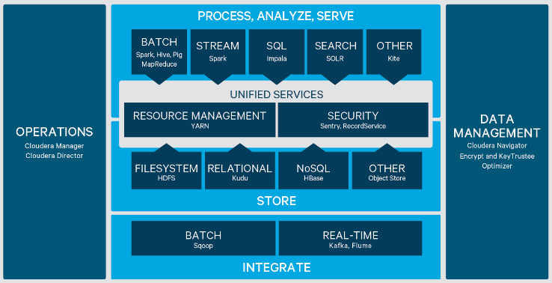
Cloudera Architecture – sourced from Cloudera Differences

